Slide 1
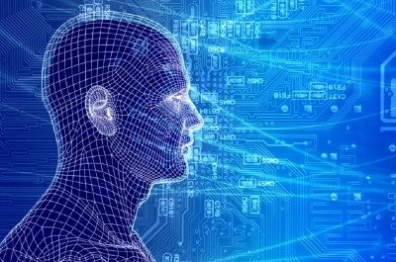
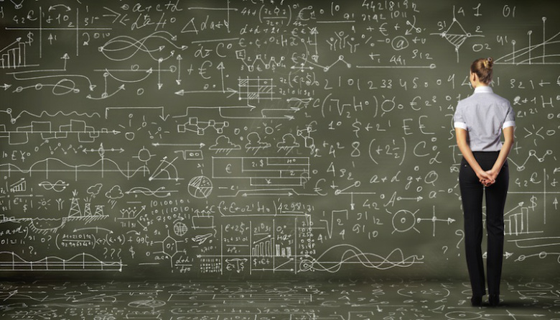
What’s Going On With Machine Learning? (a bit of an industry view)
David Meyer
dmm@{1-4-5.net, uoregon.edu, brocade.com,,..}

Slide 2
Agenda
What is all the ML excitement about?
Very Briefly: What is ML and why do we care?
A Bit on Anomaly Detection using ML (day job)
Q&A

Slide 3
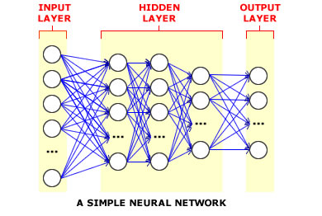
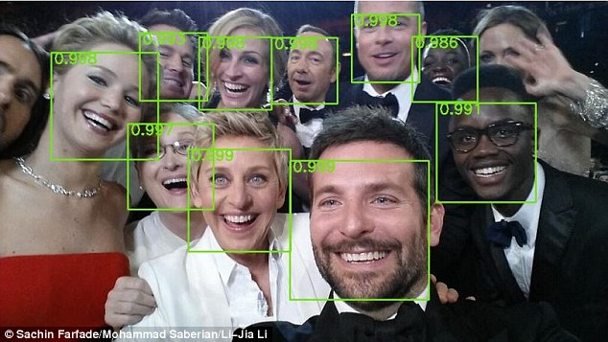
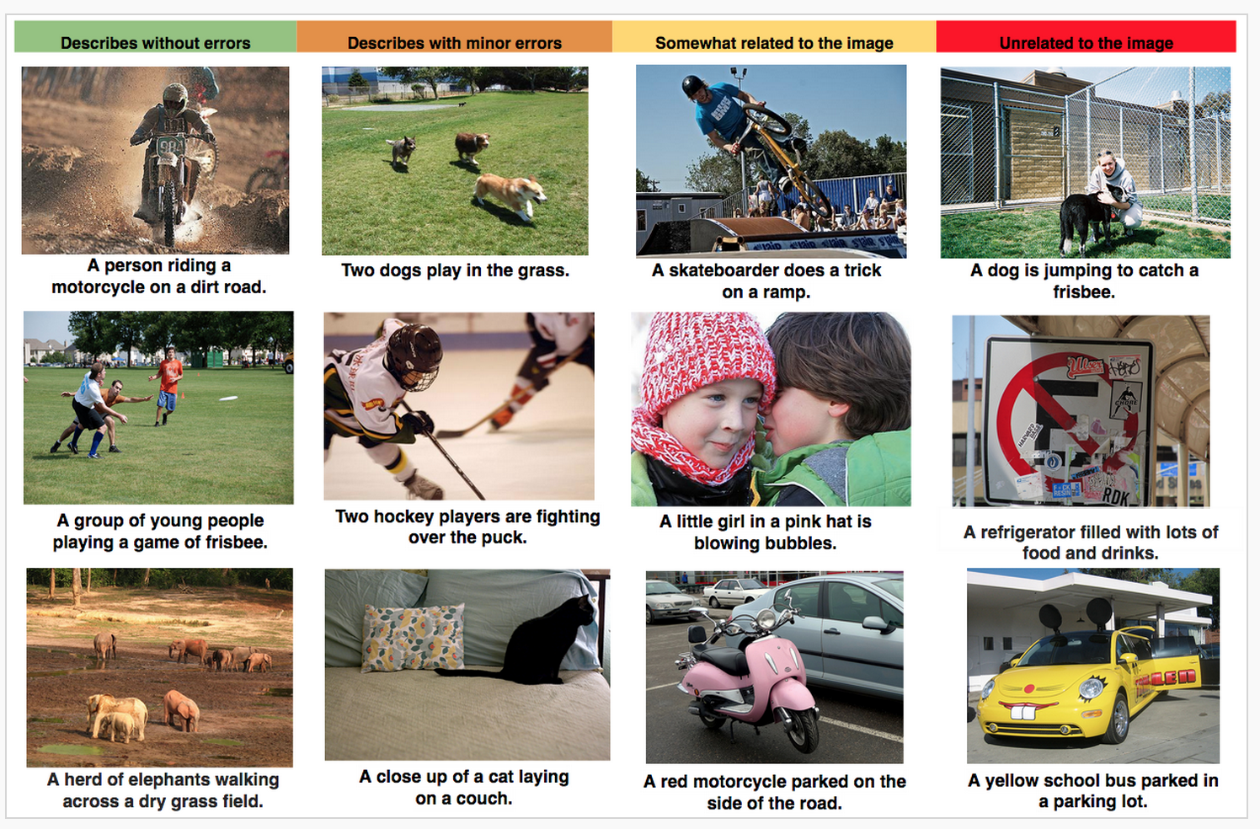
Ok, What is All the ML Excitement About?
Deep learning is enjoying great success in an ever expanding number of use cases
Multi-hidden layer neural networks
Map vectors to vectors (FF) or sequences to sequences (RNN,...)
“Perceptual” tasks reaching super-human performance
Non-cognitive domains still lagging
Auto-Captioning
Object Recognition

Slide 4
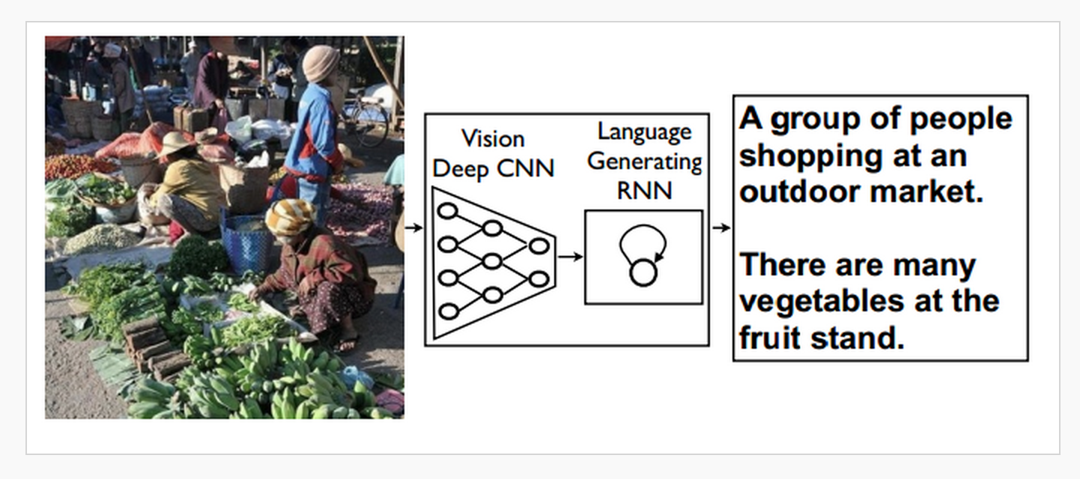
Auto-Captioning How it Works Cartoon

Slide 5
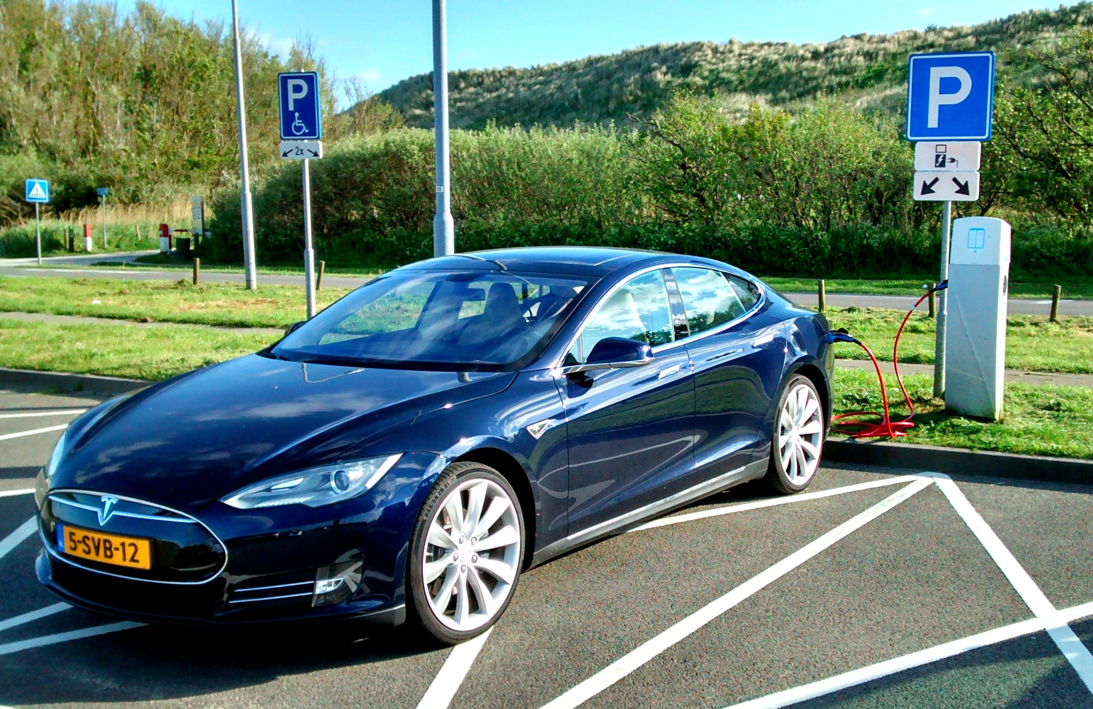
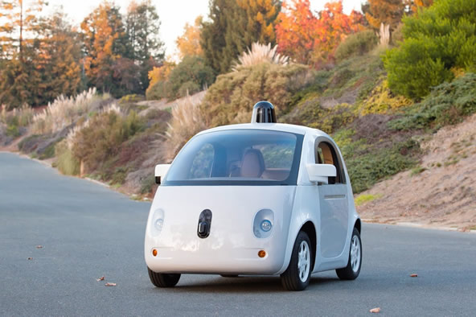

Self-Driving Cars
Notes:
Note massive 750Mb/

Slide 6
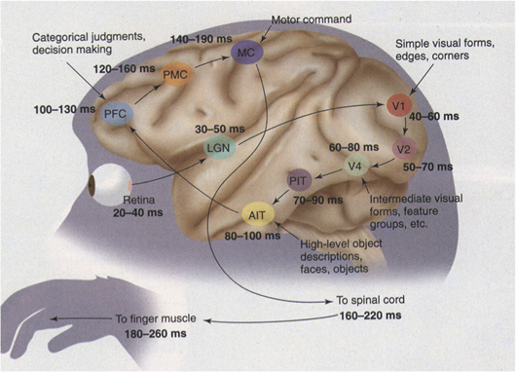
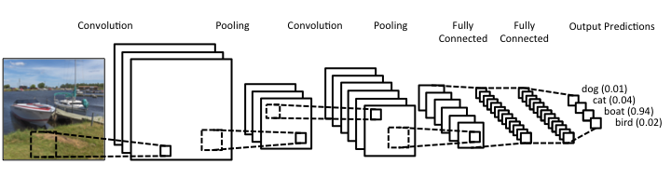
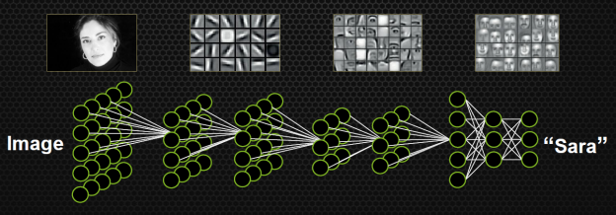
How Does Your Car Actually See?
How your car (camera, …) sees
Convolutional Neural Nets (CNNs)
How your brain sees
Hierarchical &
Composable
Representations
http://www.cns.nyu.edu/heegerlab/content/publications/Tolhurst-VisNeurosci1997a.pdf
Slide courtesy Simon Thorpe
See http://www.wired.com/2015/05/wolframs-image-rec-site-reflects-enormous-shift-ai/
Courtesy Simon Thorpe

Slide 7
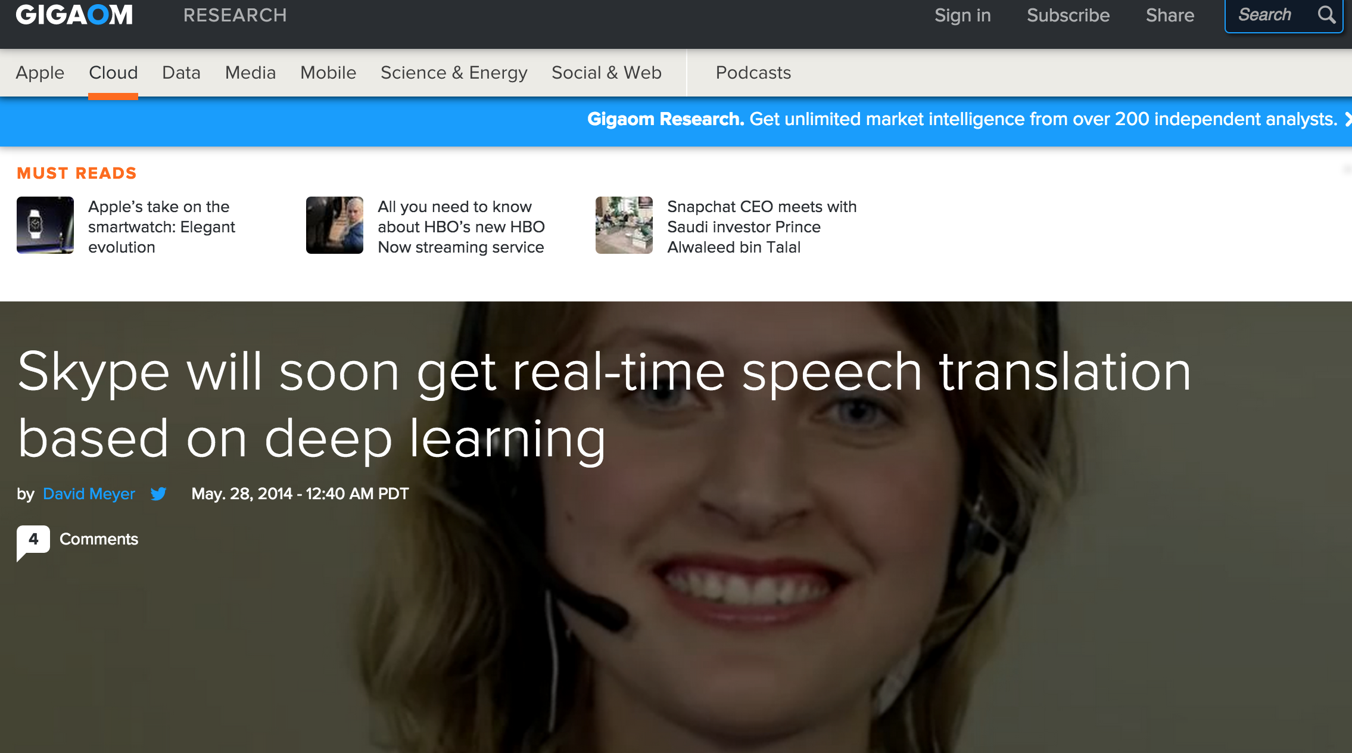
But There’s More

Slide 8

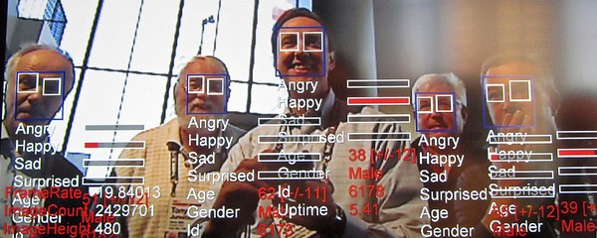
Think Speech/Object Recognition is Impressive?

Slide 9
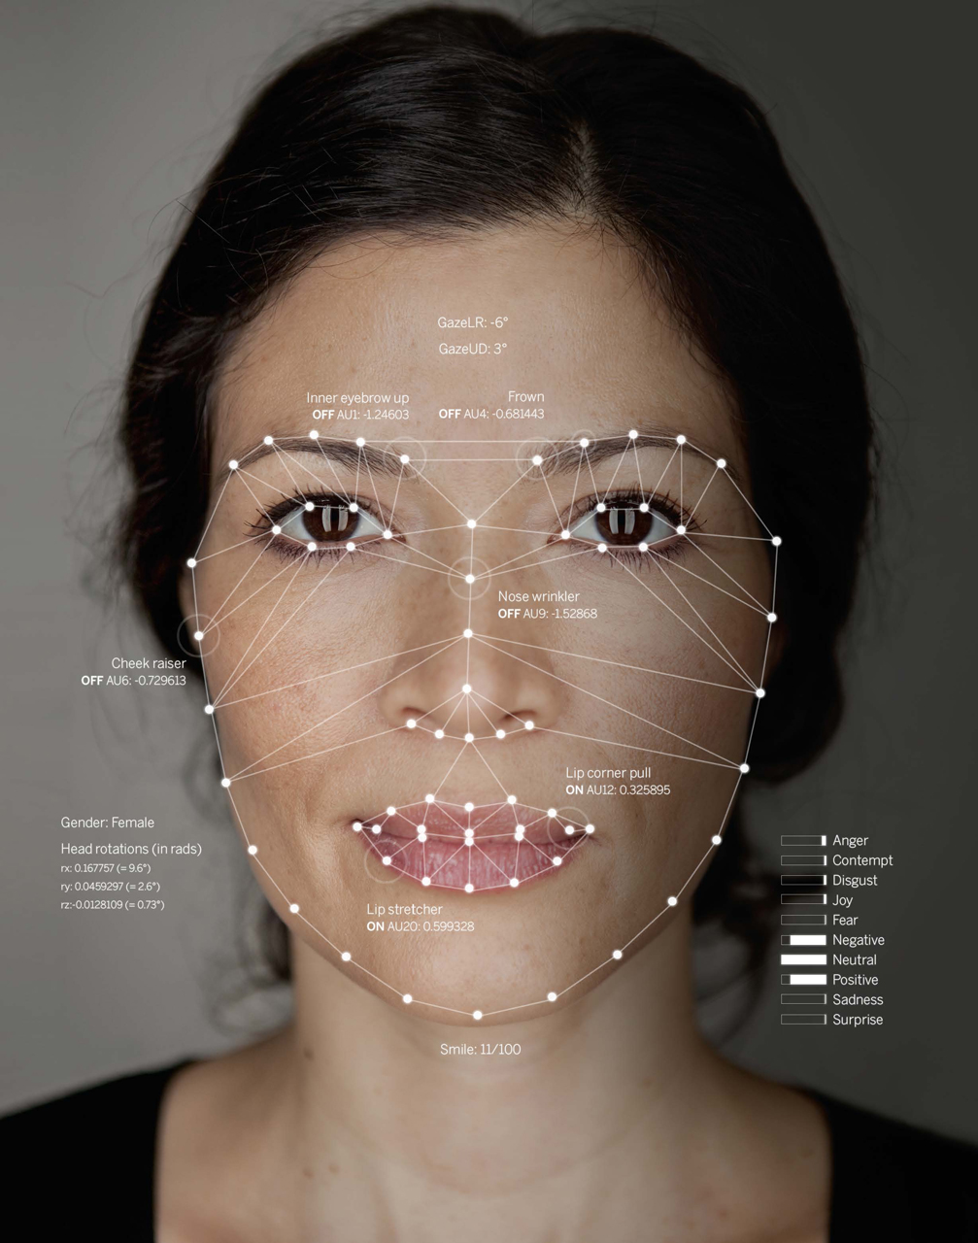

So How Does This Work?
Facial Keypoints
Jelena Stajic et al. Science 2015;349:248-249
Published by AAAS
Notes:
Illustration of how a virtual interviewer sees a human. The interviewer assesses the psychological state of the human by tracking and analyzing their facial expressions, body posture, and speech.

Slide 10
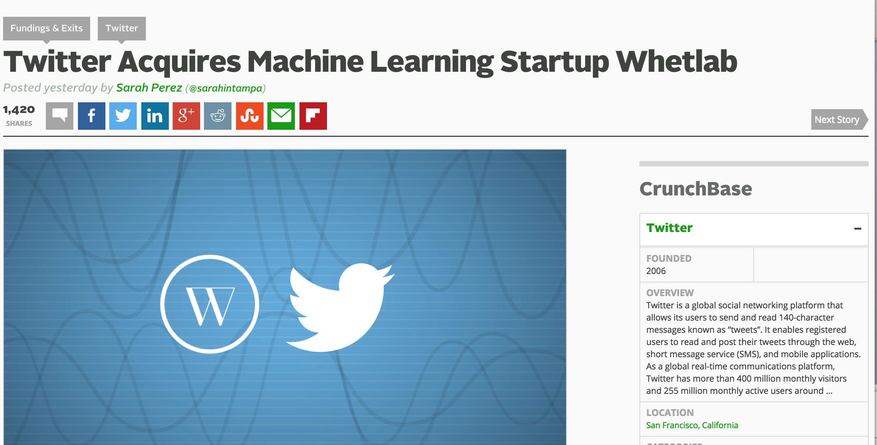
Everyone is getting into the game (M&A Gone Wild)
More Recently
http://www.cruxialcio.com/twitter-joins-ai-race-its-new-team-cortex-10393

Slide 11
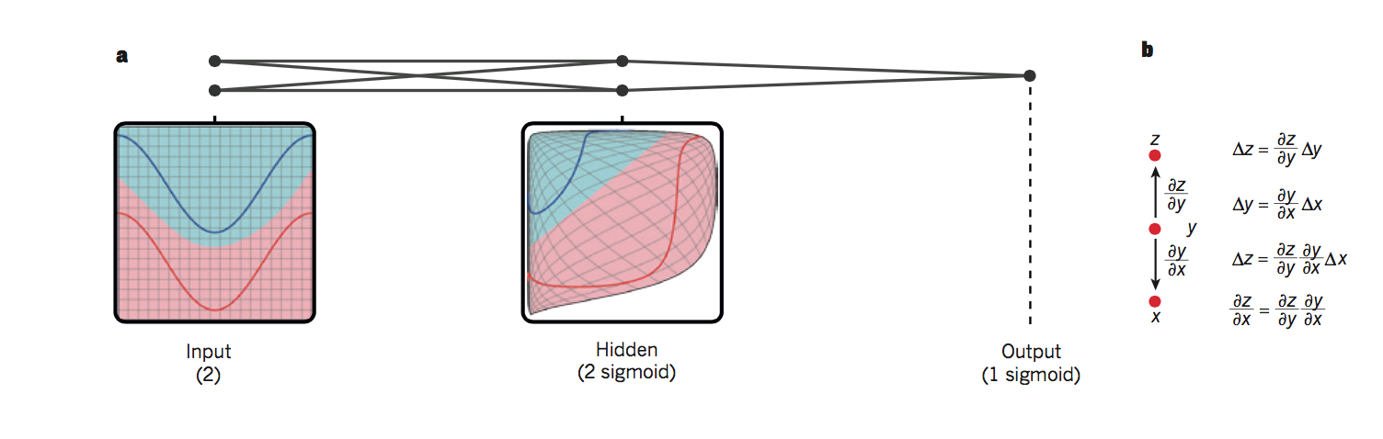
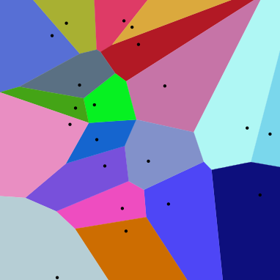
So What is Really Happening Here?
Linear Decision Boundary
Deep Nets disentangle the underlying explanatory
factors in the data so as to make them linearly separable
Graphic courtesy Christopher Olah
Voronoi diagram under Euclidian distance
Voronoi diagram under Euclidian distance
Linear Separability in a Neural Network
Linear Separability in a Neural Network

Slide 12
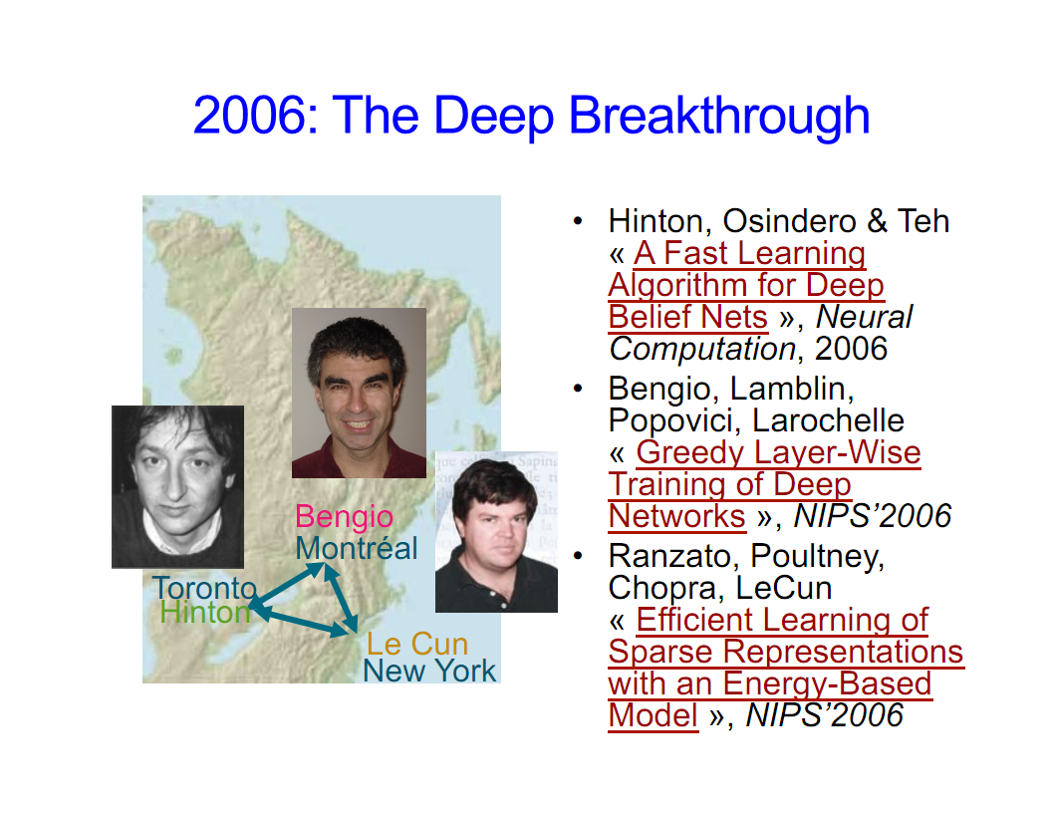
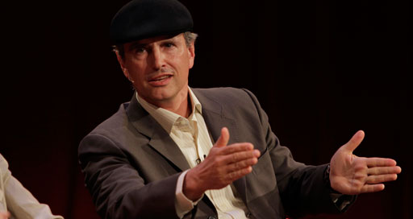
Why is this all happening now?
Before 2006 people thought deep neural networks couldn’t be trained
So why now?
Theoretical breakthroughs in 2006
Learned how to train deep neural networks
Technically: Solved the vanishing/exploding gradient problem(s) (“butterfly effects”)
More recently: http://www.cs.toronto.edu/~fritz/absps/momentum.pdf
Nice overview of LBH DL journey: http://chronicle.com/article/The-Believers/190147/
Compute
CPUs were 2^20s of times too slow
Parallel processing/algorithms
GPUs + OpenCL/CUDA
Datasets
Massive data sets: Google, FB, Baidu, …
And the convergence of theory/practice in ML
Alternate view of history?
LBH Nature DL review: http://www.nature.com/nature/journal/v521/n7553/full/nature14539.html
Jürgen Schmidhuber’s critique : http://people.idsia.ch/~juergen/deep-learning-conspiracy.html
LBH rebuttal: http://recode.net/2015/07/15/ai-conspiracy-the-scientists-behind-deep-learning/
Image courtesy Yoshua Bengio

Slide 13
Agenda
What is all the ML excitement about?
Very Briefly: What is ML and why do we care?
A Bit on Anomaly Detection using ML (day job)
Q&A

Slide 14
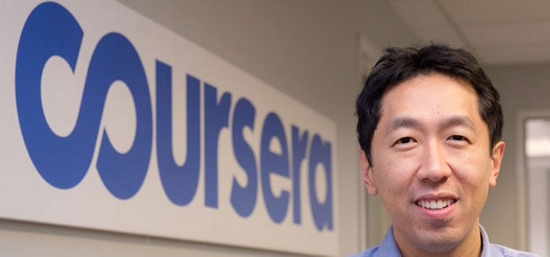
All Cool, But What is Machine Learning?
The complexity in traditional computer programming is in the code (programs that people write). In machine learning, learning algorithms are in principle simple and the complexity (structure) is in the data. Is there a way that we can automatically learn that structure? That is what is at the heart of machine learning.
-- Andrew Ng
Said another way, we want to discover the Data Generating Distribution (DGD) that underlies the data we observe. This is the function that we want to learn.
Moreover, we care about primarily about the generalization accuracy of our model (function)
Accuracy on examples we have not yet seen
as opposed the accuracy on the training set (note: overfitting)

Slide 15
The Same Thing Said in Cartoon Form
Traditional Programming
Machine Learning
Data
Computer
Output
Program
In short, learning in a Machine Learning setting
outputs a program (read: code) that runs on a
specialized “abstract machine”
Data
Computer
Program
Output

Slide 16
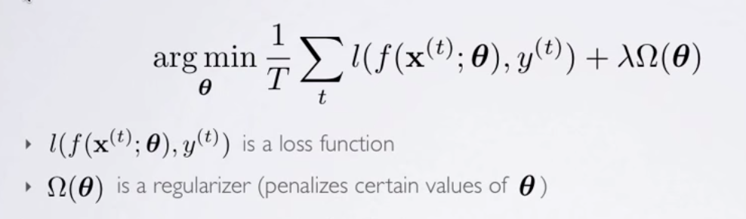
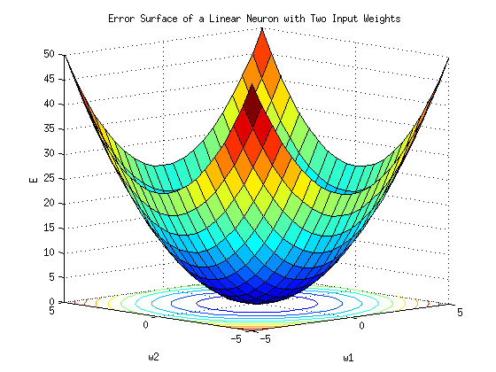
A Little More Detail
Machine Learning is a procedure that consists of estimating model parameters so that the learned model can perform a specific task (sometimes called Narrow or Weak AI; contrast AGI)
Approach: Estimate model parameters (usually denoted θ) such that prediction error is minimized
Empirical Risk Minimization casts learning as an optimization problem
3 Main Classes of Machine Learning Algorithms
Supervised
Unsupervised
Reinforcement learning
Semi-supervised learning
Supervised learning
Here we show the learning algorithm a set of examples (x_{i}) and their corresponding outputs (y_{i})
You are given a training set {(x_{i},y_{i})} where y_{i} = f(x_{i}). We want to learn f
Essentially have a “teacher” that tells you what each training example is
See how closely the actual outputs match the desired ones
Note generalization error (bias, variance) vs. accuracy on the training set
Most of the big breakthroughs have come in supervised deep learning
Unsupervised Learning
Algorithm learns internal representations and important features
Unlabeled data sets
Reinforcement Learning
Learning agent maximizes future reward
Dynamic system with feedback control
Robots
Images courtesy Hugo Larochelle and Andrew Ng

Slide 17
Aside: Feed Forward Neural Networks
Artificial Neurons
The information is propagated from the inputs to the outputs
Directed Acyclic Graph (DAG)
Computes one or more non-linear functions
Computation is carried out by composition of some number of algebraic functions implemented by the connections, weights and biases of the hidden and output layers
Hidden layers compute intermediate representations
Dimension reduction, but not always
Time has no role -- no cycles between outputs and inputs
However, in some models each hidden layer models one time step (e.g, RNN)
Maps vectors to vectors
Output layer
2nd hidden
layer
1st hidden
layer
x₁
x₂
…..
x_{n}
We say that the input data, or features, are n dimensional

Slide 18
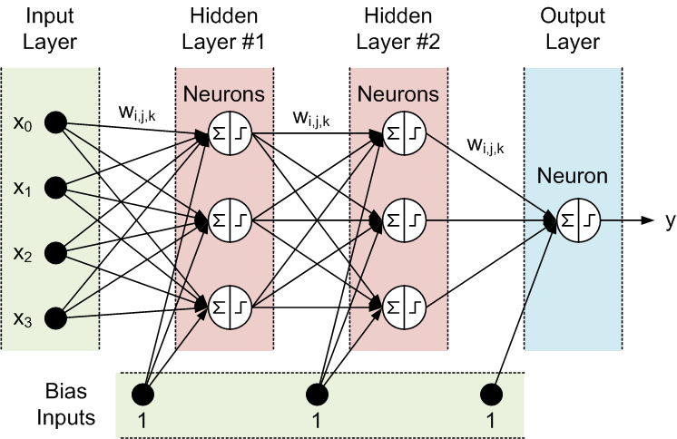
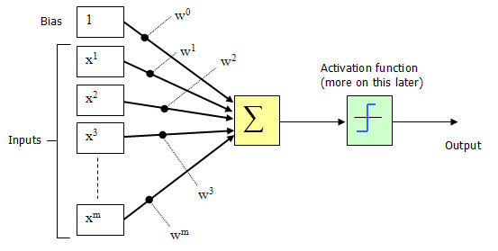
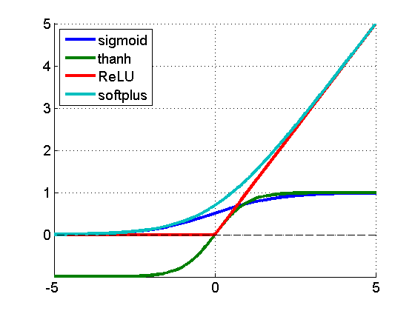
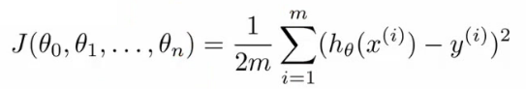
Deep Feed Forward Neural Nets (in one slide ☺)
(x^{(i)},y^{(i)})
h_{θ}(x^{(i)})
Where do the weights come from?
Hypothesis
f(x^{(i)})
Forward Propagation
So what then is learning?
Learning is the adjusting of the weights w_{i,j} such that
the cost function J(θ) is minimized
Simple learning procedure: Back Propagation (of the error signal)

Slide 19
Agenda
What is all the ML excitement about?
Very Briefly: What is ML and why do we care?
A Bit on Anomaly Detection using ML (day job)
Q&A

Slide 20
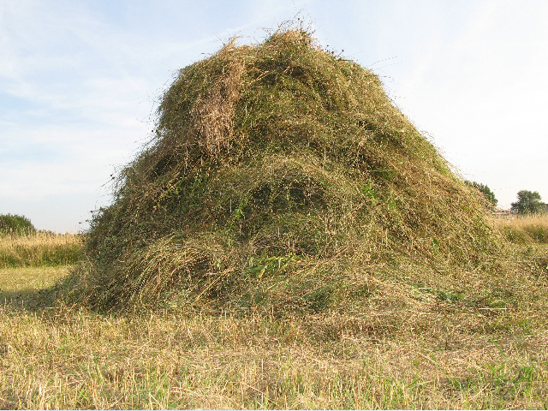
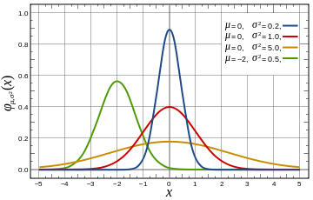
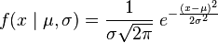
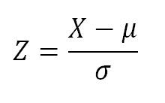
Anomaly Detection: What and Why
It is clear that one of the major challenges we face as a civilization is dealing with deluge of data that are being collected from our networks at global (and beyond) scale
While at the same time we are “knowledge starved”
Can’t find the needles in an exponentially growing haystack
Anomaly Detection (aka “Outlier detection”) is one piece of the puzzle
Machine Learning is a fundamental part of the answer
Key Assumptions for Anomaly Detection
Anomalous events occur relatively infrequently (alternatively: most events normal)
Second order assumption: Common events follow a Gaussian distribution (likely to be wrong)
What is obvious: When anomalous events do occur, their consequences can be quite serious and often have substantial negative impact on our businesses, security, …

Slide 21
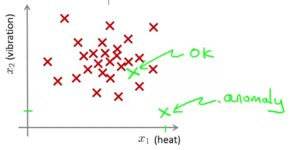
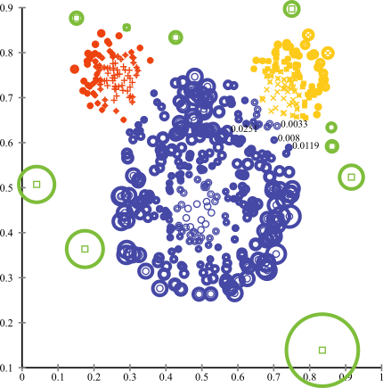
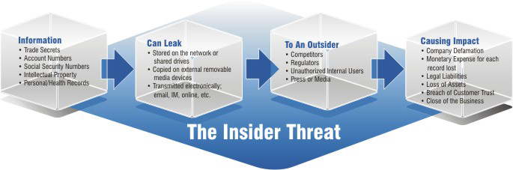
So What are Anomalies?
An anomaly is a pattern that does not conform to the expected behaviour
An observation that deviates so significantly from other observations
so as to arouse suspicion that it was generated by a different mechanism, or just far from expected…
How to define expected behaviour?
How to find the “outliers”?
Anomalies translate to significant real life events
Cyber intrusions
Cyber crime
Manufacturing/product defects
…
Linear Decision Boundary
Graphic courtesy Andrew Ng, others

Slide 22
Basic Idea Behind Anomaly Detection
An anomaly
Idea: Assume that a boundary exists and that - Nominal data is inside the boundary - Anomalous data is outside the boundary
Problem: How to estimate/approximate the boundary?
Problem: What measurement(s) caused the anomaly (selection/observer bias)?
Collected ‘Nominal’ Data
Problem: How far off-nominal is the anomaly/feature?

Slide 23
Simple Example
N₁ and N₂ are regions of normal behaviour
Say, normal flows in a network
Points o₁ and o₂ are anomalies
Points in region O₃ are anomalies
Challenge:
How to define “normal” regions?
How to find the outlier points?
Y
N₁
o₁
O₃
o₂
N₂
X

Slide 24
3 Main Types of Anomaly
Point Anomalies
Contextual Anomalies
Collective Anomalies

Slide 25
Point Anomalies
An individual data instance is anomalous if it deviates significantly from the rest of the data set.
Y
Anomaly
N₁
o₁
O₃
o₂
N₂
X

Slide 26
Contextual Anomalies
Individual data instance is anomalous within a context
Requires a notion of context
Also referred to as conditional anomalies
Anomaly
Normal

Slide 27
Collective Anomalies
A collection of related data instances is anomalous
Requires a relationship among data instances
Sequential Data
Spatial Data
Graph Data
The individual instances within a collective anomaly are not anomalous by themselves
Anomalous Subsequence
Anomalous Subsequence

Slide 28
Key Challenges for Anomaly Detection Algorithms
Defining a representative normal region is challenging
The boundary between normal and outlying behaviour is often not precise
The exact notion of an outlier is different for different application domains
Availability of labelled data for training/validation (supervised learning)
Malicious adversaries
Data is very noisy
False positive/negatives
Normal behaviour keeps evolving

Slide 29

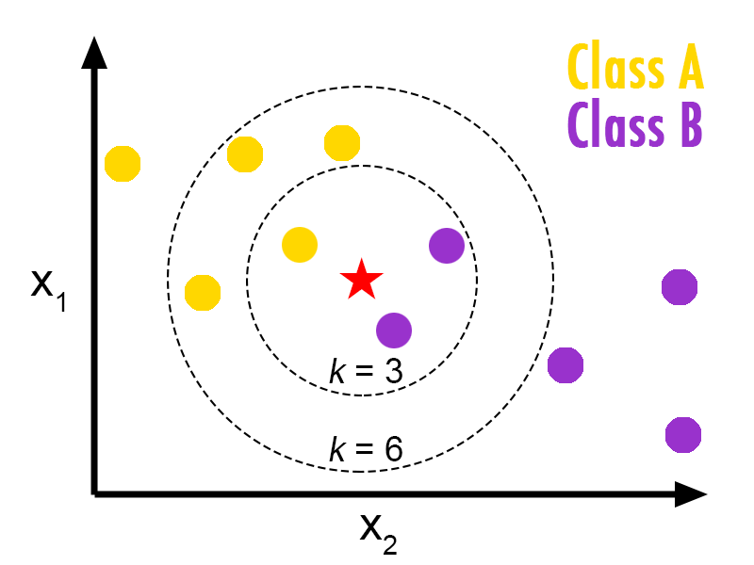
Really Simple Anomaly Detection k-Nearest Neighbors
Instance-Based Learning
Very Simple Algorithm
Given a training set {(x_{i},y_{i}),…,(x_{n},y_{n})}
Do nothing (lazy learner, supervised learning)
Given an instance x_{q} to classify
Find the instance x_{i} that is most similar to x_{q}
Return the class value of x_{i}, namely y_{i}
Task: Classify the green point
Idea: data points that are “similar” are likely
to be in the same object class (smoothness)
The hyper-parameter k describes how many similar neighbors
to consider. Neighbors then “vote” for most likely class label.

Slide 30
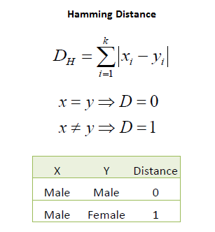
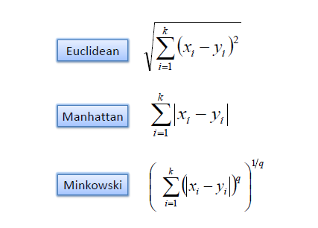
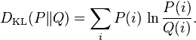
How to Measure Similarity? (how to find the instance x_{i} that is most similar to x_{q})
Distance Metrics
Hamming Distance
Kullback–Leibler Divergence
Continuous Variables
Categorical/Discrete Variables
Measures the information
lost when Q is used to
approximate P

Slide 31
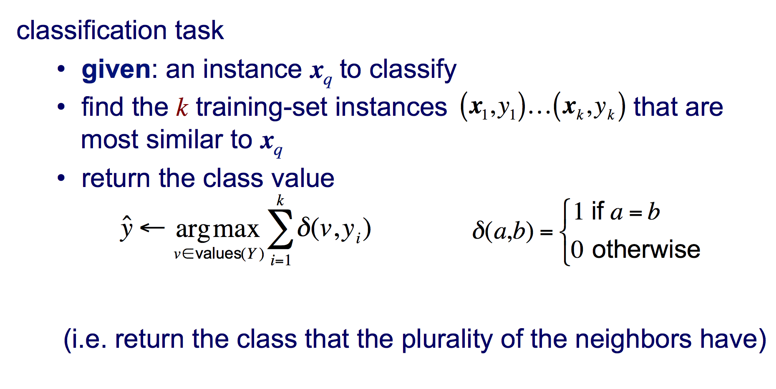
Putting It All Together
voting
Slide courtesy Pedro Domingos

Slide 32
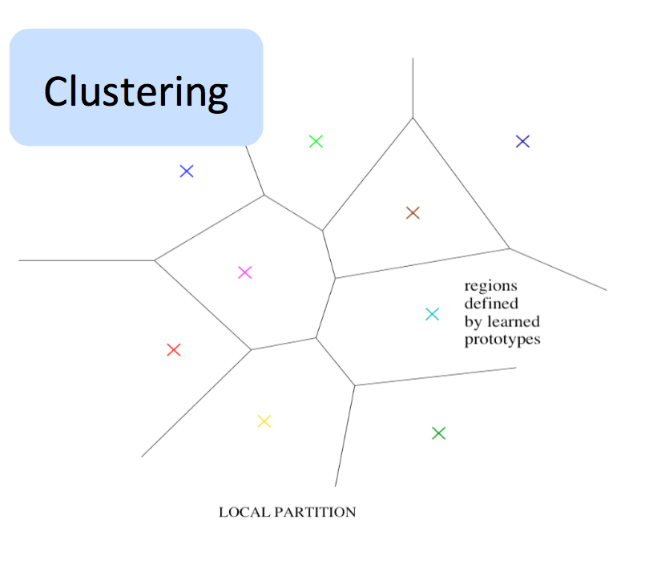
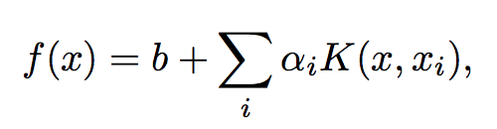
Ok, Why Aren’t We Done?
We want to build statistical models that generalize to unseen cases
Algorithms like k-NN can’t efficiently do this as they are local estimators
Local in the sense that the value of the learned function at x depends mostly on training examples that are close to x
Partition the input space into some number of regions, each with its own set of parameters
But for any interesting target function there can be an exponential number of variations
→ need representative examples for all relevant variations in order to classify them
→ can need an exponential number of parameters and training examples
Local Estimators compute non-distributed representations
Clustering, n-grams, k-NN, RBF SVMs,
local non-parametric density estimation & prediction,
decision trees, kernel machines,…
Need parameter set per distinguishable region
# of distinguishable regions is linear in # of parameters
→ No non-trivial generalization to regions without examples

Slide 33
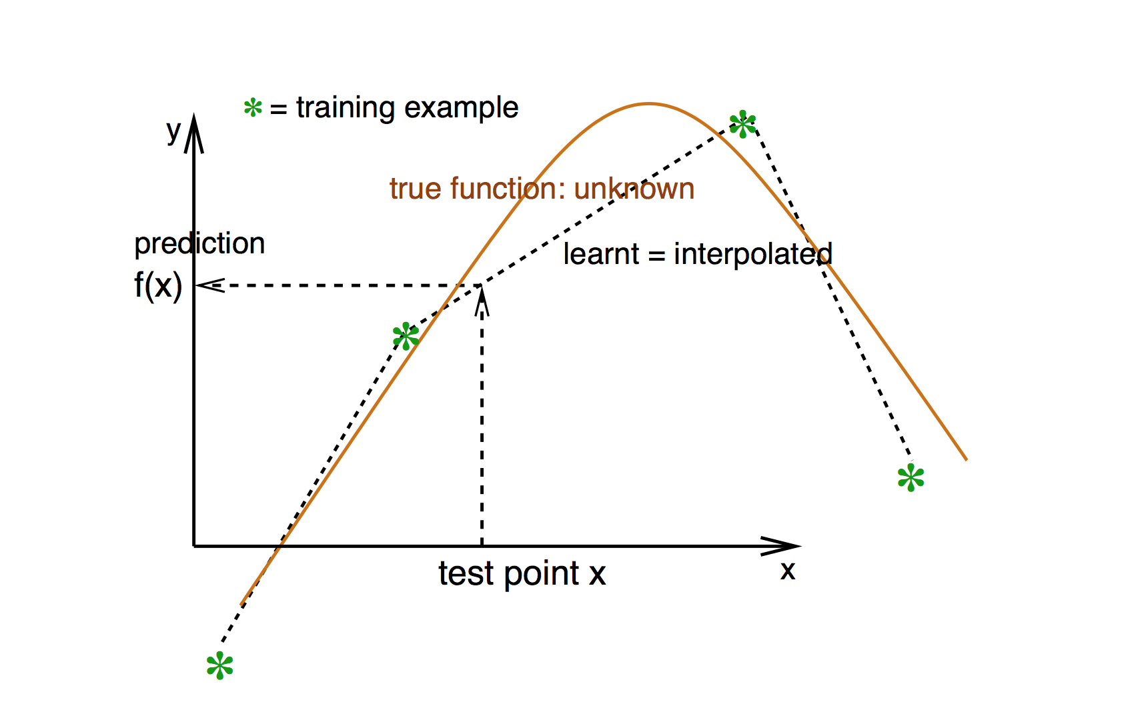
Local Estimation Relies on Smoothness (most basic “prior”)
Smoothness → If x is geometrically close to x’ then f(x) ≈ f(x’)
Graphic courtesy Yoshua Bengio

Slide 34
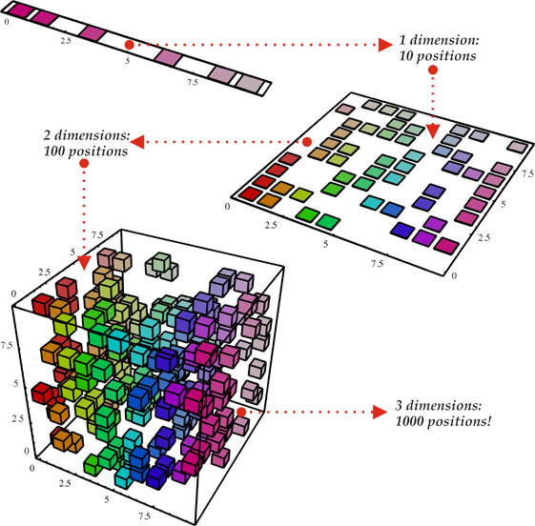
Smoothness, however, cannot defeat The Curse of Dimensionality
(i). Space grows exponentially
(ii). Space is stretched, points become equidistant
Basically: There are exponentially many configurations of the variables to consider

Slide 35
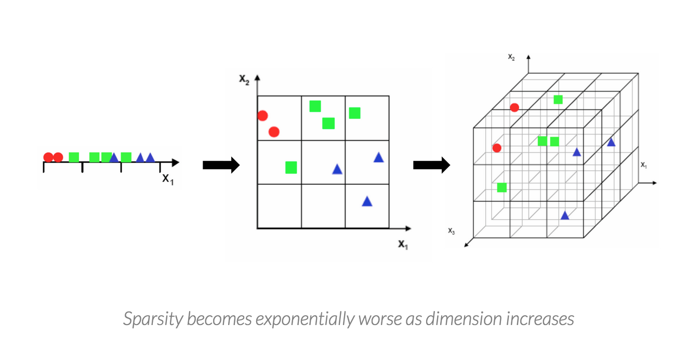
Seen Another Way
The Curse of Dimensionality is what makes generalization hard
(number of variations in the target function grows exponentially)
http://nicolas.le-roux.name/publications/Bengio06_curse.pdf

Slide 36
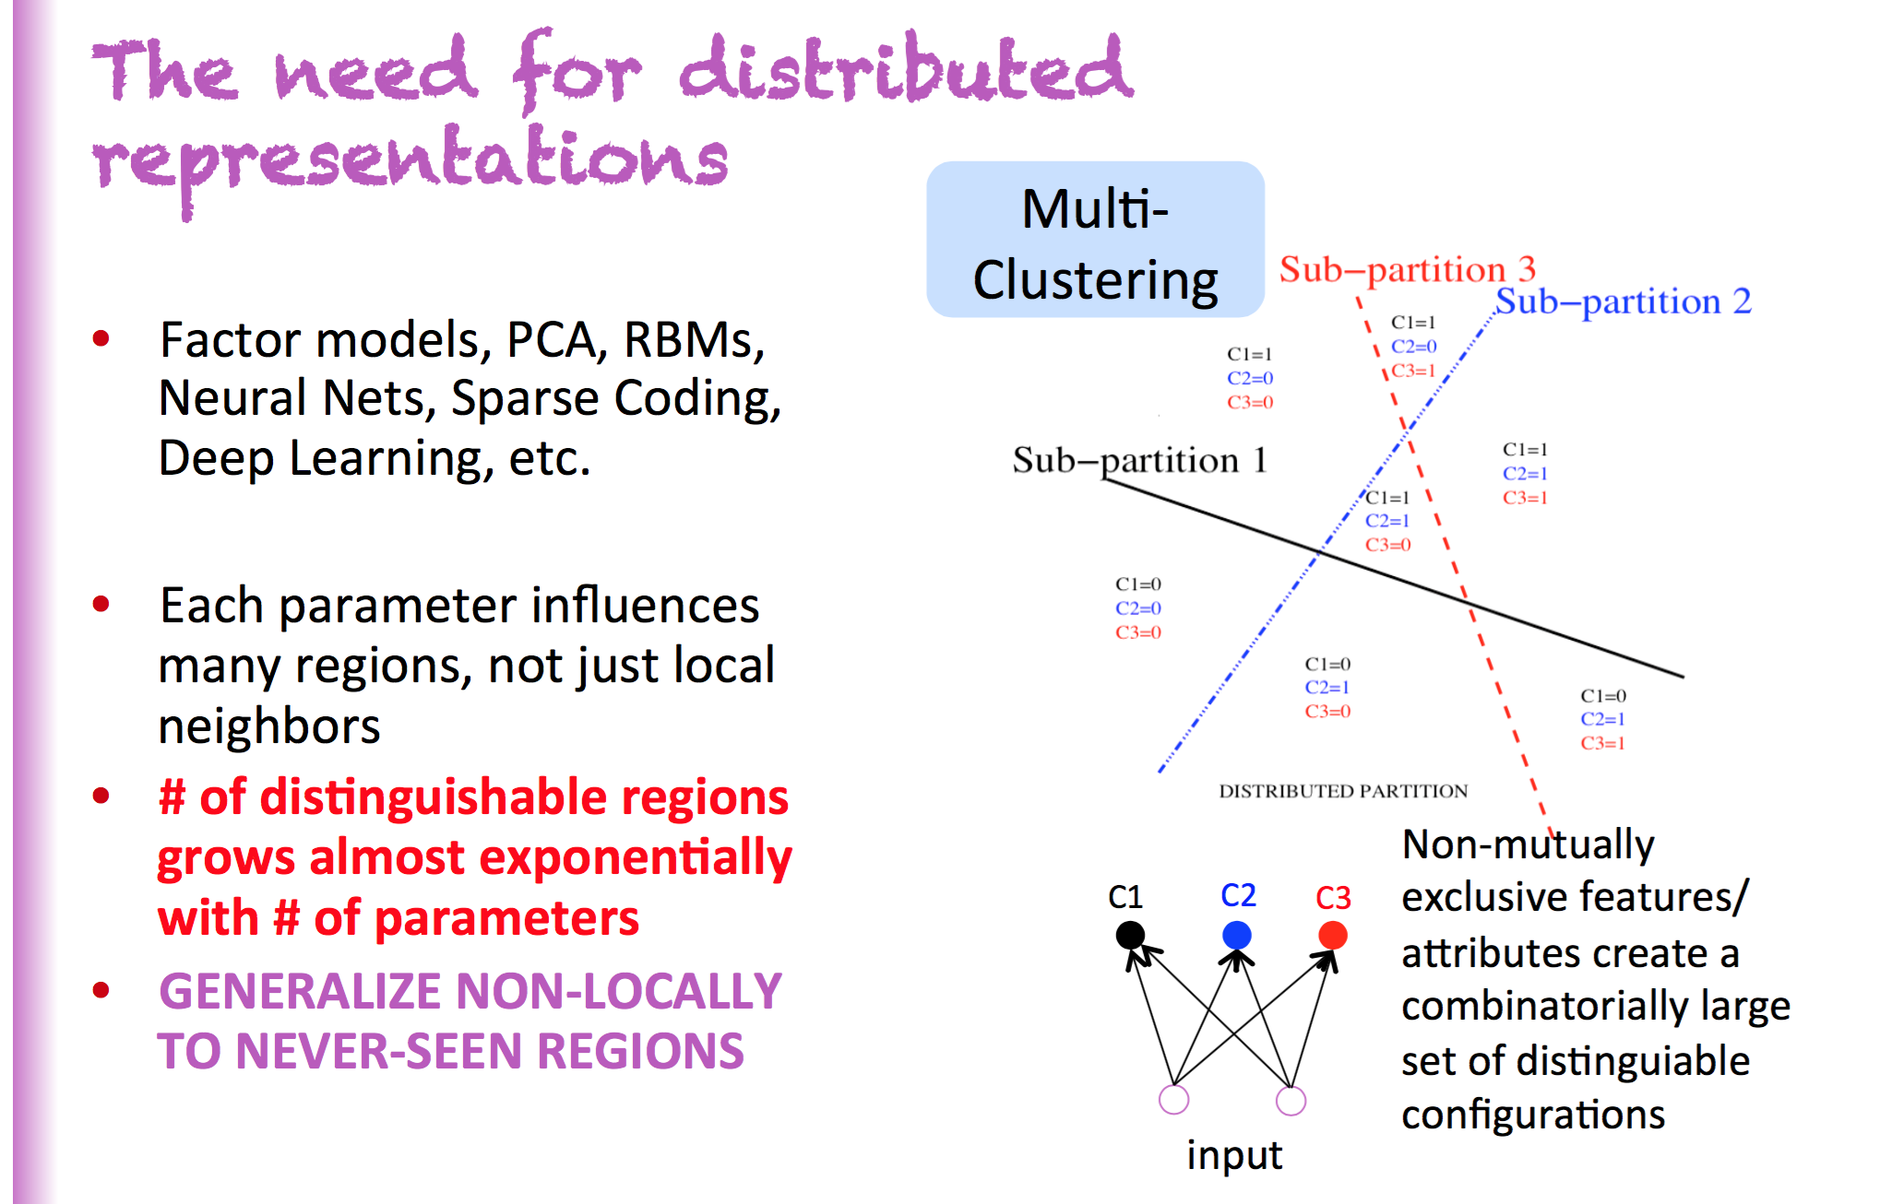
So We Need Distributed Representations
Slide courtesy Yoshua Bengio

Slide 37
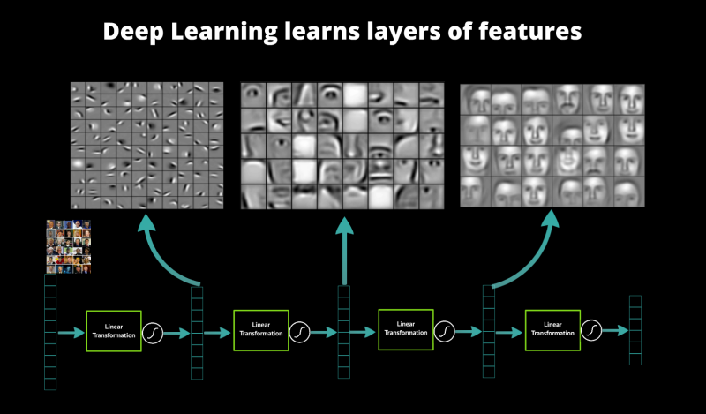
A Bit More on ML Algorithm Representational Power
Voronoi Diagram
Local Estimation
Unique parameters/region
Can be exponentially many regions
Distributed Representation
Reuses “patterns” (e.g., Gabor filters)
Exponentially more powerful that LE

Slide 38
A Few Quick Takeaways
Most “simple” ML algorithms are local estimators
Clustering, n-grams, NN, RBF SVMs,…
Likely won’t generalize well when data/target function is complex
OTOH, distributed representations
can buy exponential gain in generalization
Deep composition of non-linearities
also buys exponential gain in generalization
Both yield non-local generalization
which is what we’re after
So how do we build algorithms and software systems that can
accurately detect a wide variety of anomalies in quasi-real time
mitigate false positive/negatives
generalize to novel attacks

Slide 39
Agenda
What is all the ML excitement about?
Very Briefly: What is ML and why do we care?
A Bit on Anomaly Detection using ML (day job)
Q&A

Slide 40
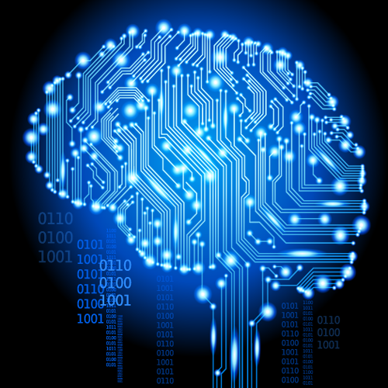
Q&A
Thanks!

